Slide 1
Graph concept and terminology
Dr. Yasir | Programming Domain

Slide 2
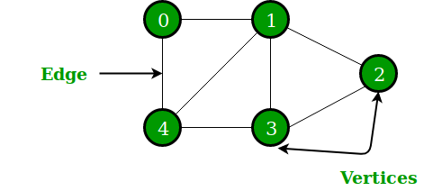
A Graph is a non-linear data structure consisting of nodes and edges. The nodes are sometimes also referred to as vertices and the edges are lines or arcs that connect any two nodes in the graph.
Set of vertices V = {0,1,2,3,4}
Set of edges E = {01, 12, 23, 34, 04, 14, 13}.
Notes:
Insert a map of your country.

Slide 3
Application of graphs
Graphs are used to solve many real-life problems. Graphs are used to represent networks. The networks may include paths in a city or telephone network or circuit network.
Graphs are also used in social networks like linkedIn, Facebook. For example, in Facebook, each person is represented with a vertex(or node).
Notes:
Insert a map of your country.

Slide 4
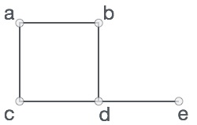
Formally, a graph is a pair of sets (V, E), where V is the set of vertices and E is the set of edges, connecting the pairs of vertices. Take a look at the following graph −
V = {a, b, c, d, e}
E = {ab, ac, bd, cd, de}
Notes:
Insert a map of your country.

Slide 5
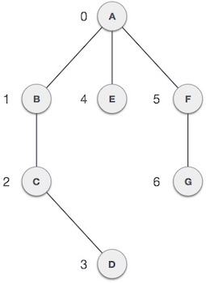
terminology
Vertex − Each node of the graph is represented as a vertex. In the following example, the labeled circle represents vertices. Thus, A to G are vertices.
We can represent them using an array as shown in the following image.
Here A can be identified by index 0. B can be identified using index 1 and so on.
Notes:
Insert a map of your country.

Slide 6
Edge − Edge represents a path between two vertices or a line between two vertices.
In the following example, the lines from A to B, B to C, and so on represents edges.
We can use a two-dimensional array to represent an array as shown in the following image.
Here AB can be represented as 1 at row 0, column 1, BC as 1 at row 1, column 2 and so on, keeping other combinations as 0.
Notes:
Insert a map of your country.

Slide 7
Adjacency − Two node or vertices are adjacent if they are connected to each other through an edge.
In the following example, B is adjacent to A, C is adjacent to B, and so on.
Notes:
Insert a map of your country.

Slide 8
Path − Path represents a sequence of edges between the two vertices.
In the following example, ABCD represents a path from A to D.
Notes:
Insert a map of your country.

Slide 9

A point is a particular position in a one-dimensional, two-dimensional, or three-dimensional space. For better understanding, a point can be denoted by an alphabet.
It can be represented with a dot.
Notes:
Insert a map of your country.

Slide 10

A Line is a connection between two points. It can be represented with a solid line.
Here, ‘a’ and ‘b’ are the points. The link between these two points is called a line.
Notes:
Insert a map of your country.

Slide 11
Degree of Vertex
It is the number of vertices adjacent to a vertex V
Degree of vertex can be considered under two cases of graphs −
Undirected Graph
Directed Graph
Notes:
Insert a map of your country.

Slide 12
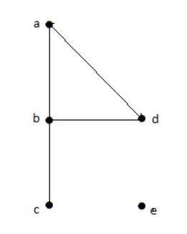
Degree of Vertex in a UNDirected Graph
deg(a) = 2, as there are 2 edges meeting at vertex ‘a’.
deg(b) = 3, as there are 3 edges meeting at vertex ‘b’.
deg(c) = 1, as there is 1 edge formed at vertex ‘c’
So ‘c’ is a pendent vertex.
deg(d) = 2, as there are 2 edges meeting at vertex ‘d’.
deg(e) = 0, as there are 0 edges formed at vertex ‘e’.
So ‘e’ is an isolated vertex
Notes:
Insert a map of your country.

Slide 13
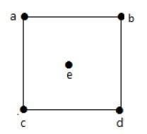
deg(a) = 2,
deg(b) = 2,
deg(c) = 2,
deg(d) = 2,
deg(e) = 0.
Notes:
Insert a map of your country.

Slide 14
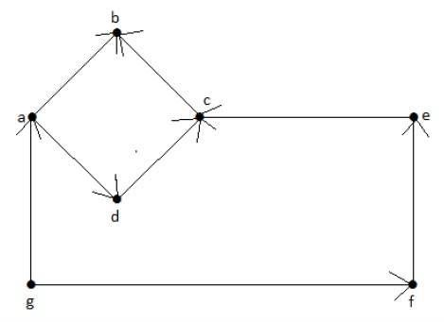
Degree of Vertex in a Directed Graph
Notes:
Insert a map of your country.

Slide 15
In a directed graph, each vertex has an indegree and an outdegree.
Indegree of vertex V is the number of edges which are coming into the vertex V. Notation − deg−(V)
Outdegree of vertex V is the number of edges which are going out from the vertex V.
Notation − deg+(V).
Notes:
Insert a map of your country.

Slide 16
Vertex ‘a’ has two edges, ‘ad’ and ‘ab’, which are going outwards. Hence its outdegree is 2.
Similarly, there is an edge ‘ga’, coming towards vertex ‘a’.
Hence the indegree of ‘a’ is 1
Notes:
Insert a map of your country.

Slide 17
Vertex | Indegree | Outdegree
a | 1 | 2
b | 2 | 0
c | 2 | 1
d | 1 | 1
e | 1 | 1
f | 1 | 1
g | 0 | 2
Notes:
Insert a map of your country.

Slide 18
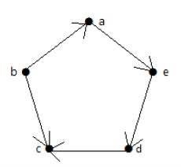
Vertex ‘a’ has an edge ‘ae’ going outwards from vertex ‘a’. Hence its outdegree is 1. Similarly, the graph has an edge ‘ba’ coming towards vertex ‘a’. Hence the indegree of ‘a’ is 1.
Notes:
Insert a map of your country.

Slide 19
Vertex | Indegree | Outdegree
a | 1 | 1
b | 0 | 2
c | 2 | 0
d | 1 | 1
e | 1 | 1
Notes:
Insert a map of your country.

Slide 20
Basic Operations
Add Vertex − Adds a vertex to the graph.
Add Edge − Adds an edge between the two vertices of the graph.
Display Vertex − Displays a vertex of the graph.
Notes:
Insert a map of your country.

